Slide 1
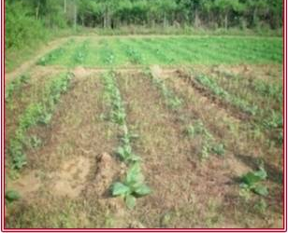
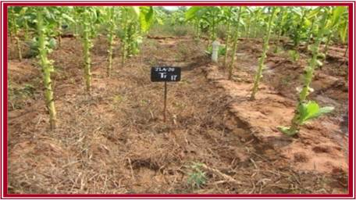
INTEGRATED WEED MANAGEMENT IN FCV TOBACCO
Monocots weeds are dominant in FCV tobacco in irrigated Alfisols and weeds in between rows are controlled by intercultural operations till ridge formation (45-50 days).
Weeds within the row and after 45-50 DAP are to be controlled by manual weeding only. In this condition, chemical spray is the best option due to labour scarcity
Two post emergence sprays of Quizalofop-ethyl @ 60 g a.i./ha at 15 and 75 DAP can be used in IWM along with intercultures to control weeds in irrigated alfisols
Quizalofop ethyl application in FCV Tobacco
Contact us: Director, ICAR – Central Tobacco Research Institute
Rajahmundry–533105, Andhra Pradesh, e-mail :directorctri@gmail.com

